Slide 1
Maturity of Enterprise Architecture Practice
Jamin Rai
MIT ( Batch 2082), BMC

Slide 2
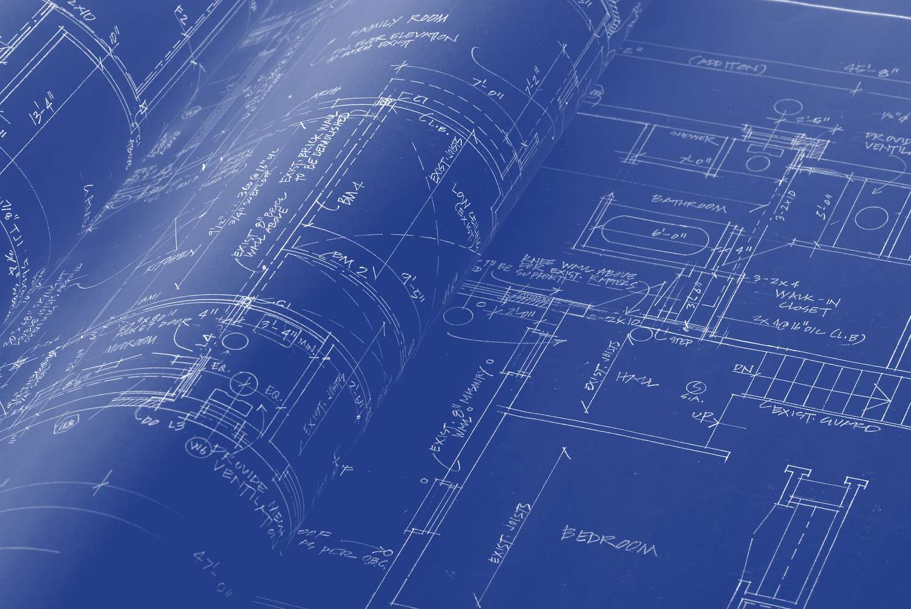
What is Enterprise Architecture (EA)?
Think of Enterprise Architecture (EA) as the master blueprint of a company — just like how a building has a blueprint showing walls, rooms, and electrical wiring, a company has an "architecture" that shows how its business goals, people, processes, and technology (IT systems) all fit together.
Imagine a big company like a school or a big shop. It has many parts: teachers/staff (business side), classrooms and books (processes), computers and internet (technology), and student records (data).

Slide 3

What is "Maturity" in EA?
Maturity means how grown-up, organized, and effective the company's EA practice is.
Low maturity = Like a messy room – things are done randomly, lots of waste and problems.
High maturity = Like a well-planned smart home – everything is organized, efficient, and improves automatically.
-------------------------------------------------------------------------------------------------------------------------------
Think of it like school grades:
A Level 1 student just started learning and makes lots of mistakes.
A Level 10 student is a topper — organised, disciplined, and getting great results.
It indicates how well an organization's current EA practices support its overall business strategy and objectives.
Companies check their EA maturity to know where they stand and how to improve. Most models use 5 levels (stages)

Slide 4
Levels of Maturity Model
Initial
Level 1
Developing
Level 2
Defined
Level 3
Managed
Level 4
Optimizing
Level 4

Slide 5
Level 01 : The 5 Levels of EA Maturity (Easy Explanation)
Initial / Ad-hoc (Starting Stage)
No proper plan. IT and business teams work separately.
Decisions are made case-by-case (like fixing problems only when they appear).
Problems: High costs, repeated mistakes, no big picture.
Example: A shop owner buys random software without thinking how it fits the whole business.

Slide 6
Level 02 : Developing / Under Development
Basic processes start.
Some rules and tools appear.
Teams begin documenting things, but it's not consistent.
EA is recognized but still not fully used.
Progress: Some projects get better, but silos (separate groups) remain.

Slide 7
Level 03 : Defined / Standardized
Clear written rules, standards, and governance (like school rules everyone follows).
EA is documented properly with diagrams and models.
Business and IT start aligning better.
Good stage: Company has a proper blueprint.

Slide 8
Level 04 : Managed / Measured
Everything is tracked with numbers (metrics).
EA is part of regular decision-making and governance.
Risks are managed, and improvements are continuous.
Leaders use EA for strategy.

Slide 9
Levl 05: Optimizing / Mature
Focus on Process Improvement.
Fully integrated with business goals.
The company adapts quickly to new technology or market changes.
Best results: Lower costs, faster growth, happy teams.

Slide 10
Why Does Maturity Matter?
Better Alignment: IT supports business goals perfectly.
Cost Saving: Less waste, fewer duplicate systems.
Faster Change/Growth: Company can adapt to new tech (like AI) quickly.
Innovation: Mature EA helps create new ideas and services.
Reduce Risk: Fewer failures in big projects.
Real-life Analogy: Think of building a house. Immature = Buying bricks randomly. Mature = Having a full architect plan, quality checks, and future upgrades ready.

Slide 11
Q. How is Maturity Assessed? (The Report Card Process) - Main parts of Enterprise Architecture practice
Business – what the organization wants to achieve and how work is done,
Data – what information is used and how it is managed,
Applications – what software systems support the work,
Technology – what hardware, networks, and technical tools are used.
Q. How is Maturity Assessed? (The Report Card Process)
EA maturity assessment is a systematic evaluation process used by organizations to determine their current level of enterprise architecture maturity.
It involves evaluating the organization's EA processes, practices, tools, and outcomes against a predefined maturity model. The assessment helps organizations understand their strengths, weaknesses, and gaps in their EA practice.

Slide 12
The TOGAF Model (Most Popular Framework)
TOGAF is the world’s most popular framework (set of rules and guidelines) for doing Enterprise Architecture properly.
Instead of guessing how to organize a big company’s technology, processes, and data, TOGAF gives you a step-by-step method that has been tested by thousands of companies.
Architecture Development Method (ADM)
Understand goals ->Plan -> Build -> Check ->Improve it continuously

Slide 13
Thank You
Jamin Rai
MIT ( Batch 2082), BMC

